Slide 1
MODS Trek
Group 3
Notes:
Outline:
Goal
Our goal is to develop an app that gives an educational, helpful and easy experience to museum visitors.
Target audience
Children
Students
Adults
Floor Map
Primary focus of app
Interactive
Zoom/auto-zoom
View each exhibit by tap
See icons of exhibits
Floor map
Customize
Chose audience
Exhibits and activities displayed change with selection
Search bar
About/Options
Provides
Operating hours
Phone number
Address
Authors
NFC
Use of NFC and Tags
Voiceover/Text-to-Speech
Personal tour guide
Thank You!
Sources

Slide 2

Goal
Our goal is to develop an app that gives an educational, helpful, and easy experience to museum visitors. The target group for the app is a wide range; from children to students, to adults. We want to give users an immersive, fun, and interactive museum experience.

Slide 3
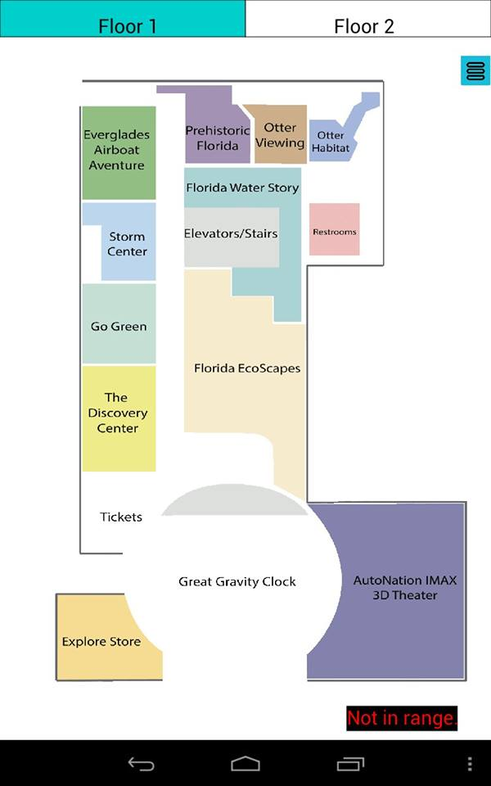
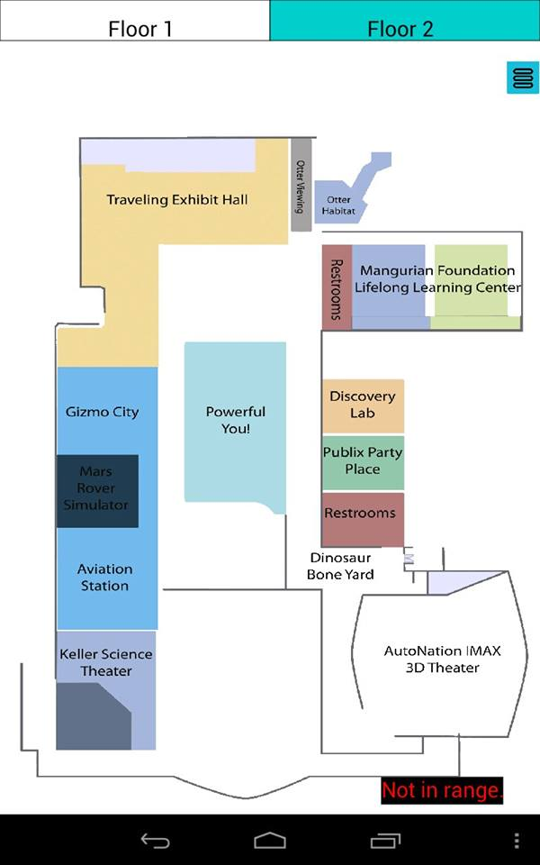
Floor Map
The app will primarily focus on a digital and interactive floor plan. At the welcome screen, the user may tap “Floor Plan” to display a map of the first floor. To view the second floor, the user will simply tap the “Second Floor” tab. The user will be able to select an audience, click on each individual exhibit, and see the icons of exhibits on display.

Slide 4
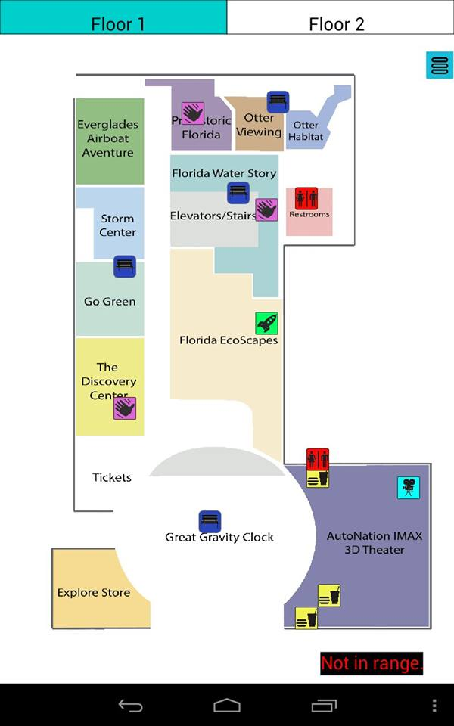
Floor Map
Tapping the menu icon presents options which allow users to customize the app. Users will be able to change the audience of the app, in turn changing exhibits and activities displayed relative to the selection made. The map will have icons representing exhibits, restrooms, food, imax, etc.

Slide 5
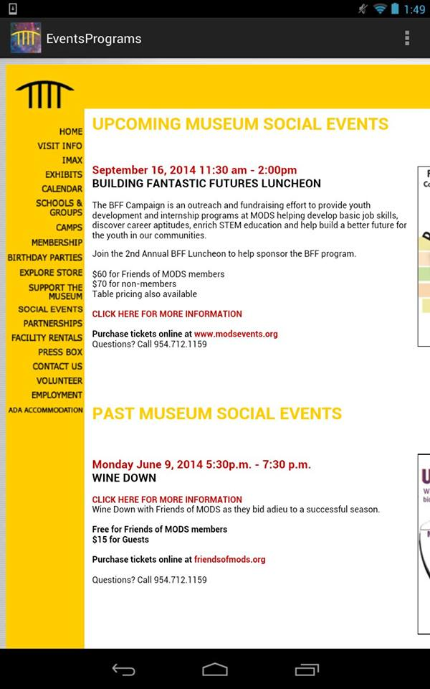
Events and Programs
Events and Programs will display upcoming and past museum events. This information, however, will come from the museum’s website to keep content accurate and up to date.

Slide 6
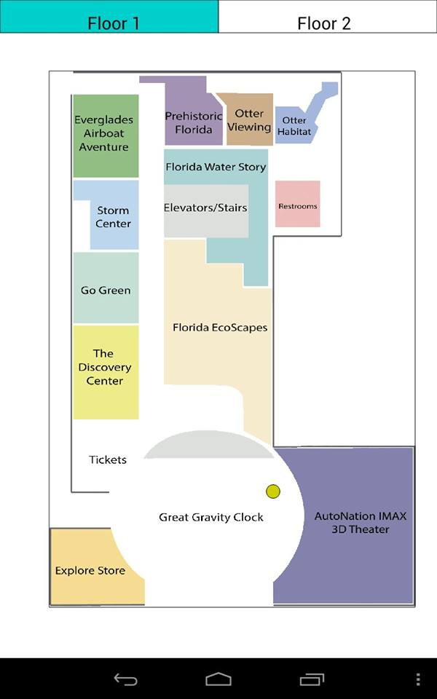
GPS
The app also uses GPS, allowing users to see precisely where they are in the museum. This makes it easier for visitors to navigate the museum, giving them more independence.
You are here

Slide 7

NFC
MODS Trek will also utilize NFC (near field communication). By placing tags throughout the museum, users can simply touch their android device to a tag, bringing them to the corresponding exhibit page.

Slide 8
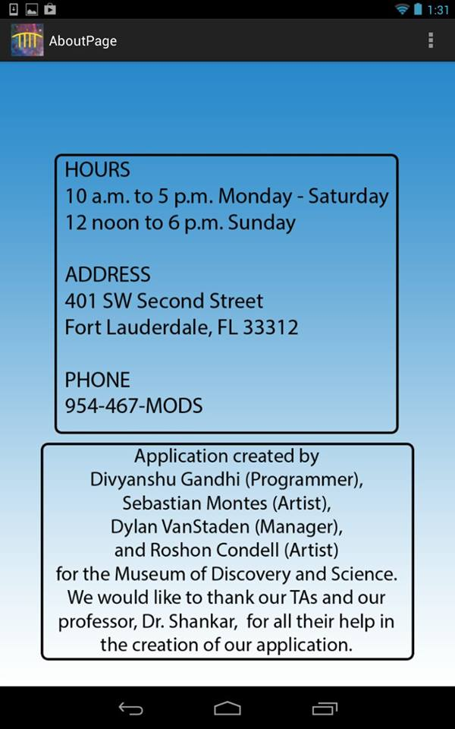
About/Options
The About/Options page will provide the operating hours, phone number, and address of the museum. About/Options will also display the developers of the application.

Slide 9
Future Plans
We hope to implement the following:
Voiceover
Mini-game

Slide 10
Questions?
Please share any questions, comments, or concerns.

Slide 11
Thank You!
We hope that you choose MODS Trek to give visitors a heightened and unique museum experience!

